Slide 1
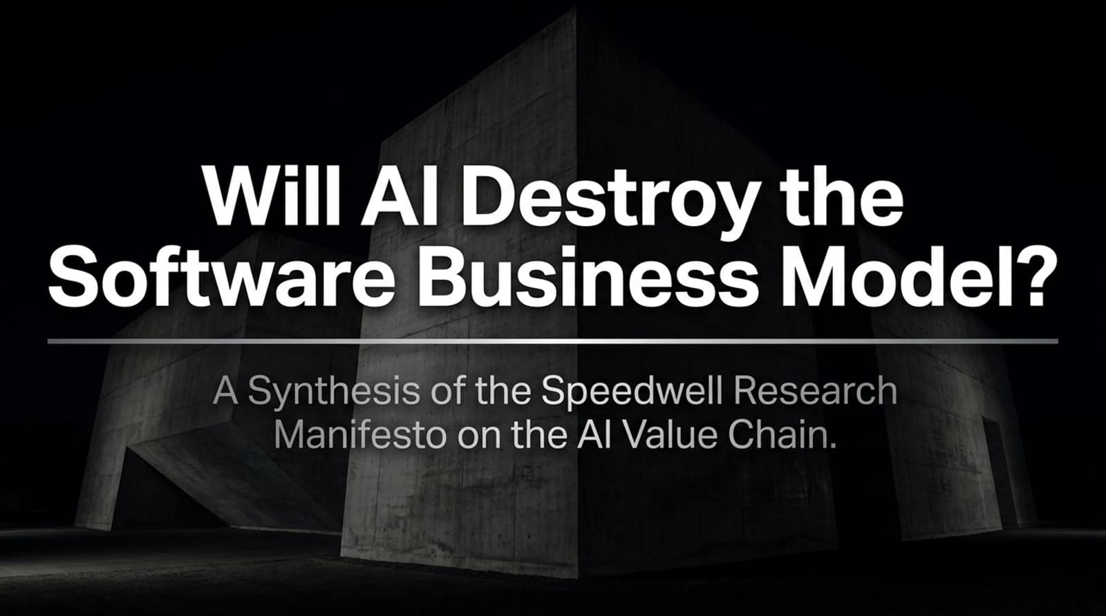
Notes:
Introduction to the Speedwell Research Manifesto on the AI Value Chain
Good morning, everyone, and welcome. Today, we are tackling one of the most contentious, high-stakes debates in technology and investing: Will AI Destroy the Software Business Model?
The presentation deck in front of you—and the insights we are breaking down today—are synthesized directly from Speedwell Research's definitive manifesto on the AI value chain and software disruption. For the last two decades, SaaS (Software-as-a-Service) has been the undisputed golden goose of the global economy. Investors loved SaaS for its predictable recurring revenue, sky-high gross margins, and deep customer lock-in.
But the sudden ascent of probabilistic foundation models, autonomous agents, and fluid natural-language interfaces has thrown the entire paradigm into question. Market panic initially suggested that AI would instantly obliterate every traditional software company, rendering code and legacy platforms obsolete overnight.
Today, we are going to look past the panic. We will examine the real architectural battle lines—from infrastructure and data warehouses to the newly coined concept of the 'Outer Harness'—to understand how software is being structurally reorganized, not just destroyed. Let's dive in.
Will AI Destroy the Software Business Model?
https://www.youtube.com/watch?v=CiBmA5r6J0U

Slide 2
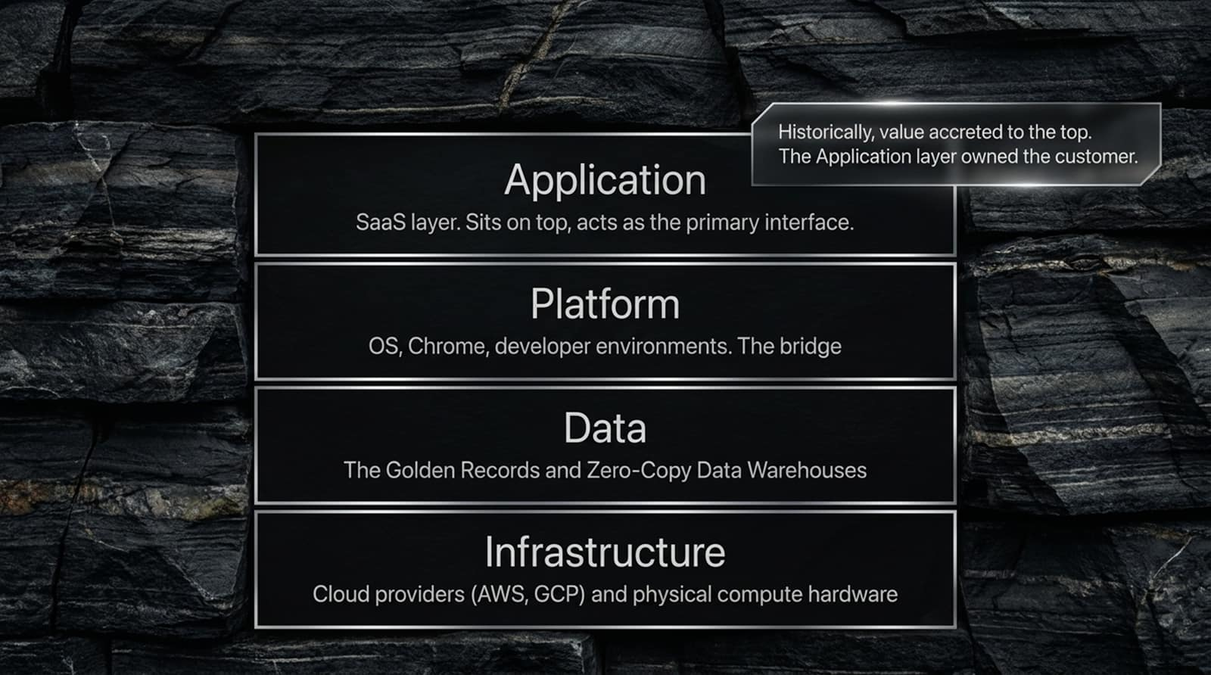
Notes:
Deterministic Moats vs. Probabilistic Disruptors
When the market panics, it often paints with too broad a brush. The initial assumption was simple: AI is going to ruin every software company instantly. But the reality on the ground is a complex, structural reorganization.
Let's look at the foundational conflict illustrated on this slide:
The Old Moat (Deterministic Code): Traditional software moats were built on hundreds of thousands of engineering hours, billions of dollars in R&D, and deep, hard-coded workflow integrations. They were deterministic, reliable, and painstakingly engineered.
The Disruptor (Probabilistic Models): AI models operate on probabilities, not hard-coded rules. They are challenging deterministic moats, rewriting the rules of distribution, and violently shifting the center of gravity for the User Interface (UI).
Software isn't disappearing overnight because enterprises cannot simply toss out decades of business logic. Instead, the relationship between user, model, and software is being completely renegotiated.

Slide 3

Notes:
The Four Layers of Enterprise Tech Stack
To understand where value is migrating, we first need to look at how the traditional enterprise tech stack is layered. Historically, the stack has four distinct tiers:
Infrastructure: Cloud providers (AWS, GCP, Azure) and physical compute hardware sitting at the foundation.
Data: The golden records, relational databases, and zero-copy data warehouses holding enterprise truth.
Platform: Operating systems, browsers (like Chrome), and developer environments acting as the bridge.
Application: The SaaS layer sitting right on top, acting as the primary human interface.
Look at the core historical dynamic highlighted on the slide: Historically, value accreted to the top. The Application layer owned the customer. If you controlled the dashboard where the accountant or sales rep spent 8 hours a day, you owned the business relationship and commanded premium pricing. AI is now threatening to upend that entire hierarchy.

Slide 4
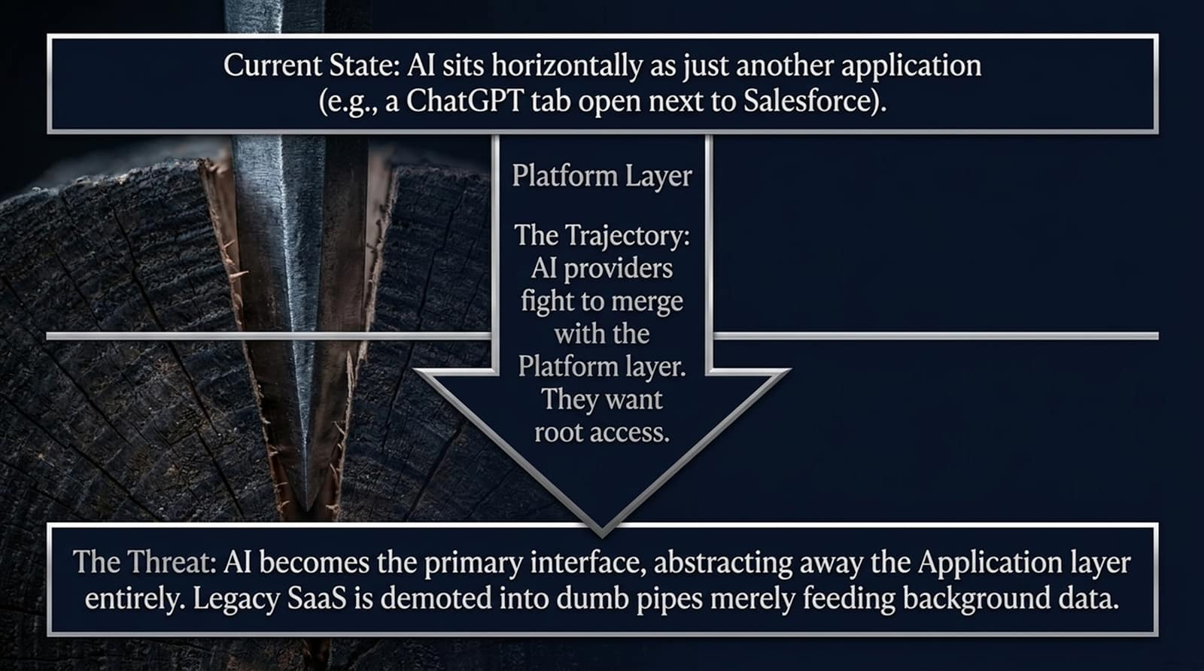
Notes:
App Disintermediation & Demotion to Dumb Pipes
Where does AI sit right now versus where is it heading?
Current State: Right now, AI sits horizontally as just another application. Think of an employee with a ChatGPT or Claude tab open right next to Salesforce or Excel. It’s a sidecar tool.
The Trajectory: AI providers are aggressively fighting to merge with the Platform layer. They want root access to your workflow.
The Threat: If AI becomes the primary conversational interface for enterprise work, it abstracts away the Application layer entirely. Legacy SaaS applications face a dangerous demotion—they risk becoming 'dumb pipes' in the background that merely feed data to the AI agent without ever being directly seen or logged into by the human user. When a customer never visits your dashboard, your pricing power evaporates.

Slide 5
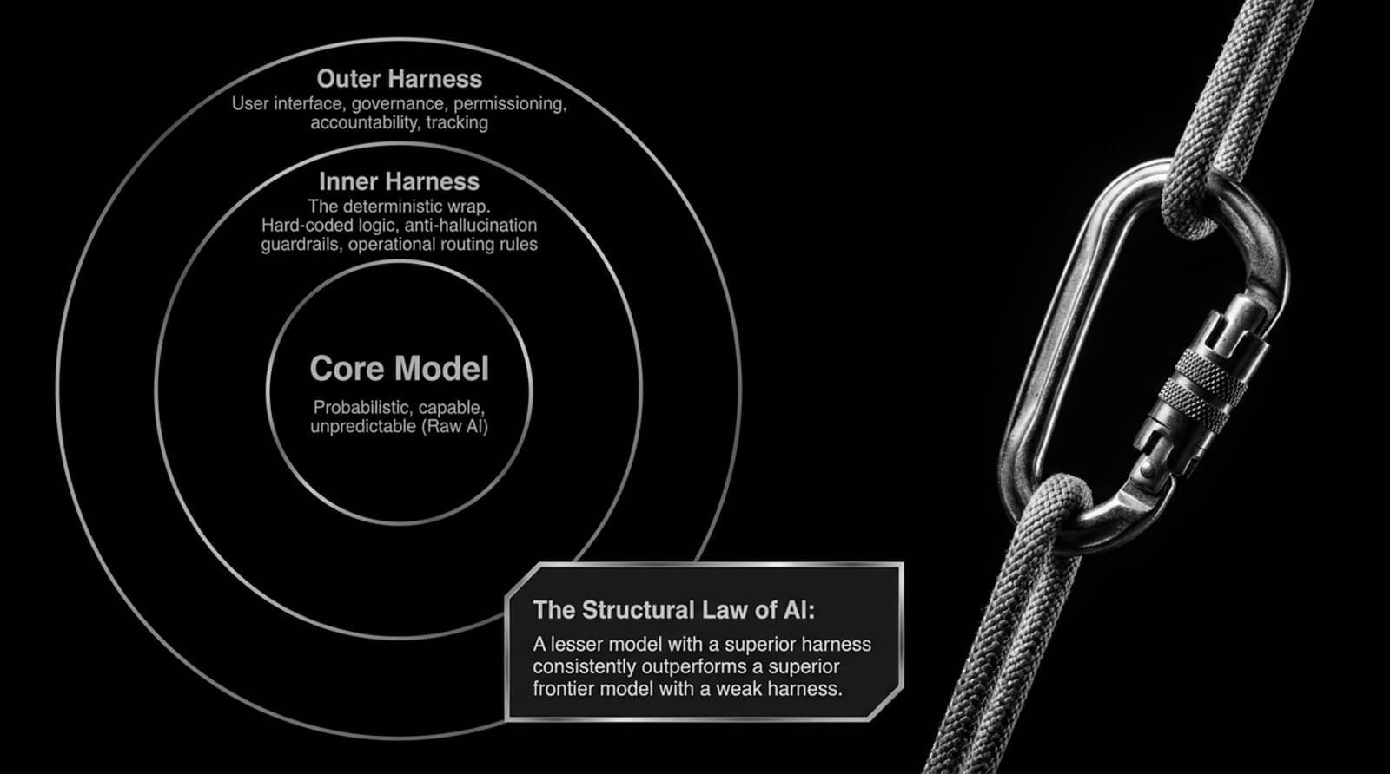
Notes:
The Inner and Outer Harness & The Structural Law of AI
To understand how companies are defending themselves, we have to look inside the AI architecture. An AI deployment consists of three concentric rings:
Core Model: The raw AI model—probabilistic, highly capable, but inherently unpredictable and prone to hallucinations.
Inner Harness: The deterministic wrap. Hard-coded logic, anti-hallucination guardrails, and operational routing rules built around the model.
Outer Harness: The user interface, governance, access permissioning, accountability, and tracking layer.
Notice the critical principle highlighted on this slide—The Structural Law of AI: 'A lesser model with a superior harness consistently outperforms a superior frontier model with a weak harness.'
Raw intelligence without enterprise governance is useless in business. The harness—specifically the Outer Harness—is where enterprise value and safety are actually established.

Slide 6
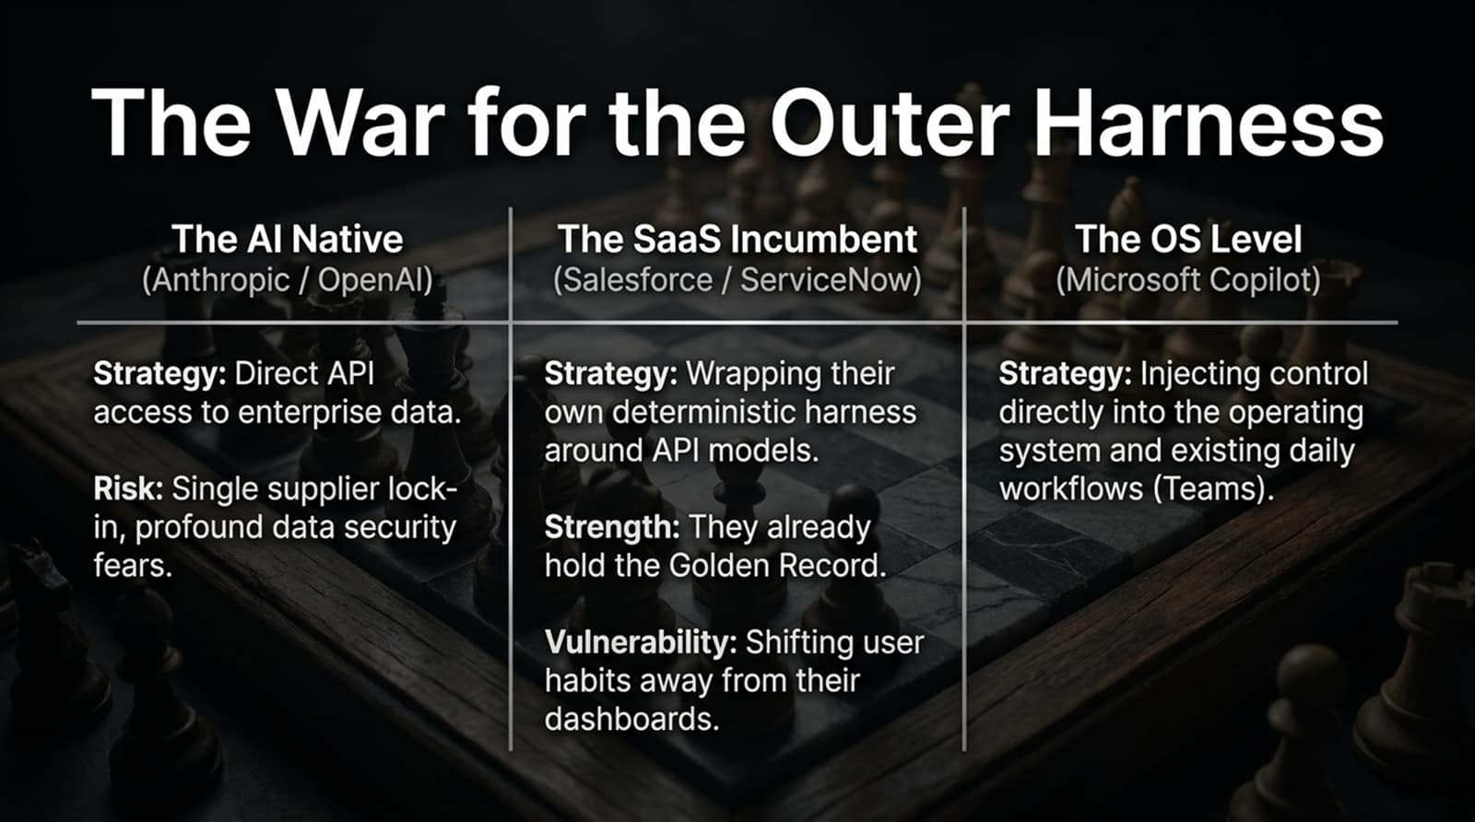
Notes:
AI-Natives vs. SaaS Incumbents vs. OS Giants
Right now, there is a three-way chess match being played for control of the Outer Harness—the interface where enterprise work actually happens:
The AI-Natives (Anthropic / OpenAI): Their strategy is to secure direct API access to enterprise data and bypass legacy apps. Their vulnerability is single-supplier lock-in fears and profound data security anxieties among enterprises.
The SaaS Incumbents (Salesforce / ServiceNow): Their strategy is wrapping their own deterministic harnesses around API models. Their massive strength is that they already hold the Golden Record and the workflow history. Their vulnerability is shifting user habits away from their dashboards.
The OS Level (Microsoft Copilot): Their strategy is injecting control directly into the operating system and daily collaboration tools like Teams and Office.
Whoever controls the Outer Harness controls the customer relationship for the next decade.

Slide 7
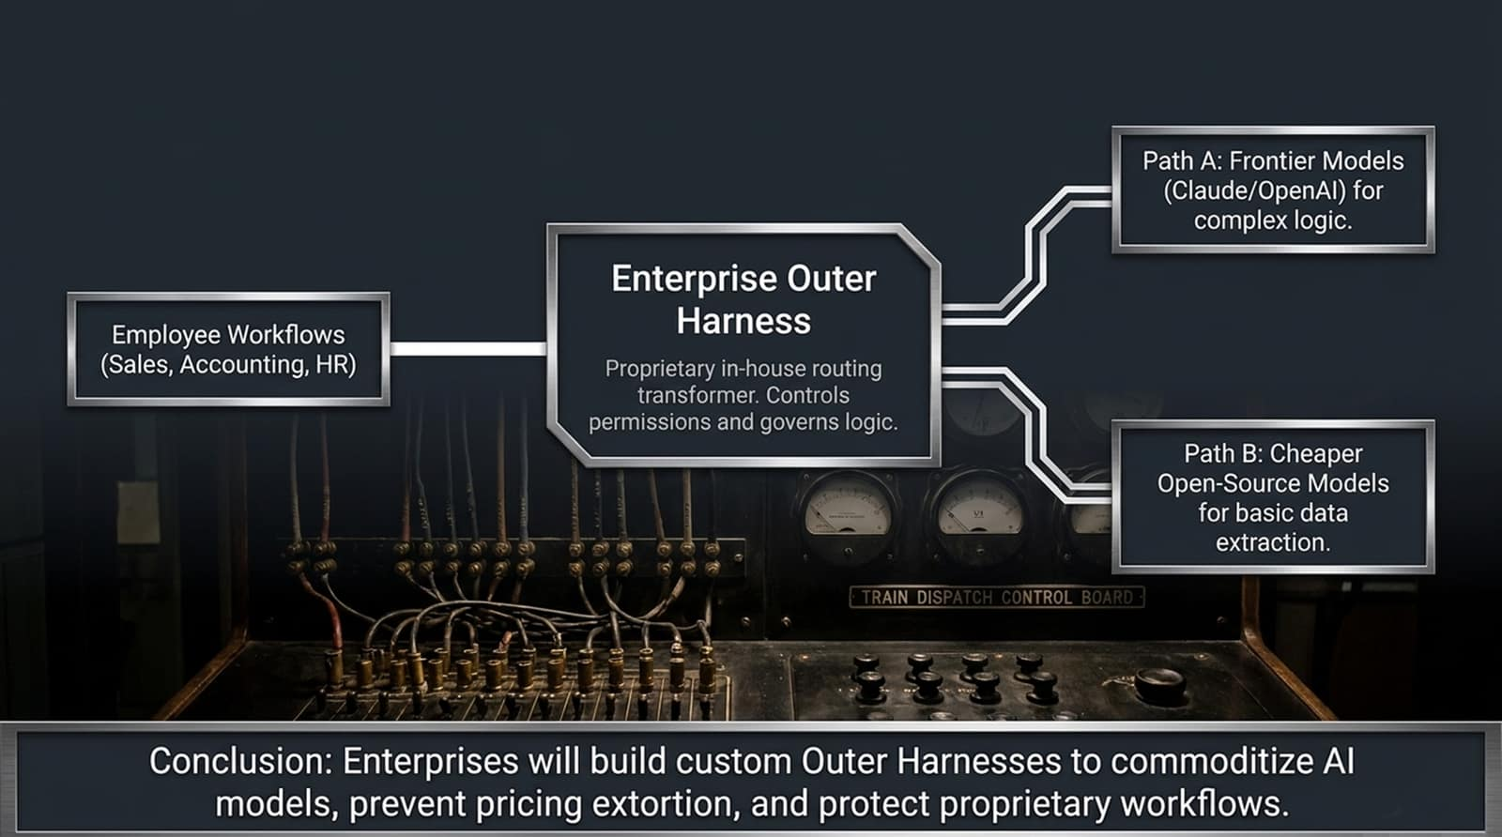
Notes:
Preventing Pricing Extortion via Proprietary Routing Transformers
How will large enterprises respond to this battle? Will they simply surrender to OpenAI or Anthropic? Absolutely not.
As shown on this slide, enterprises are building their own Enterprise Outer Harnesses—proprietary, in-house routing layers that control permissions and govern logic.
Employee workflows feed into this internal harness.
The harness then intelligently routes tasks dynamically: Path A sends complex logic queries to expensive frontier models like Claude or GPT-4o, while Path B routes basic data extraction and summarization tasks to cheap open-source models.
Conclusion: Enterprises will build custom Outer Harnesses to commoditize underlying AI models, prevent pricing extortion from single vendors, and protect their proprietary workflows and data security.

Slide 8
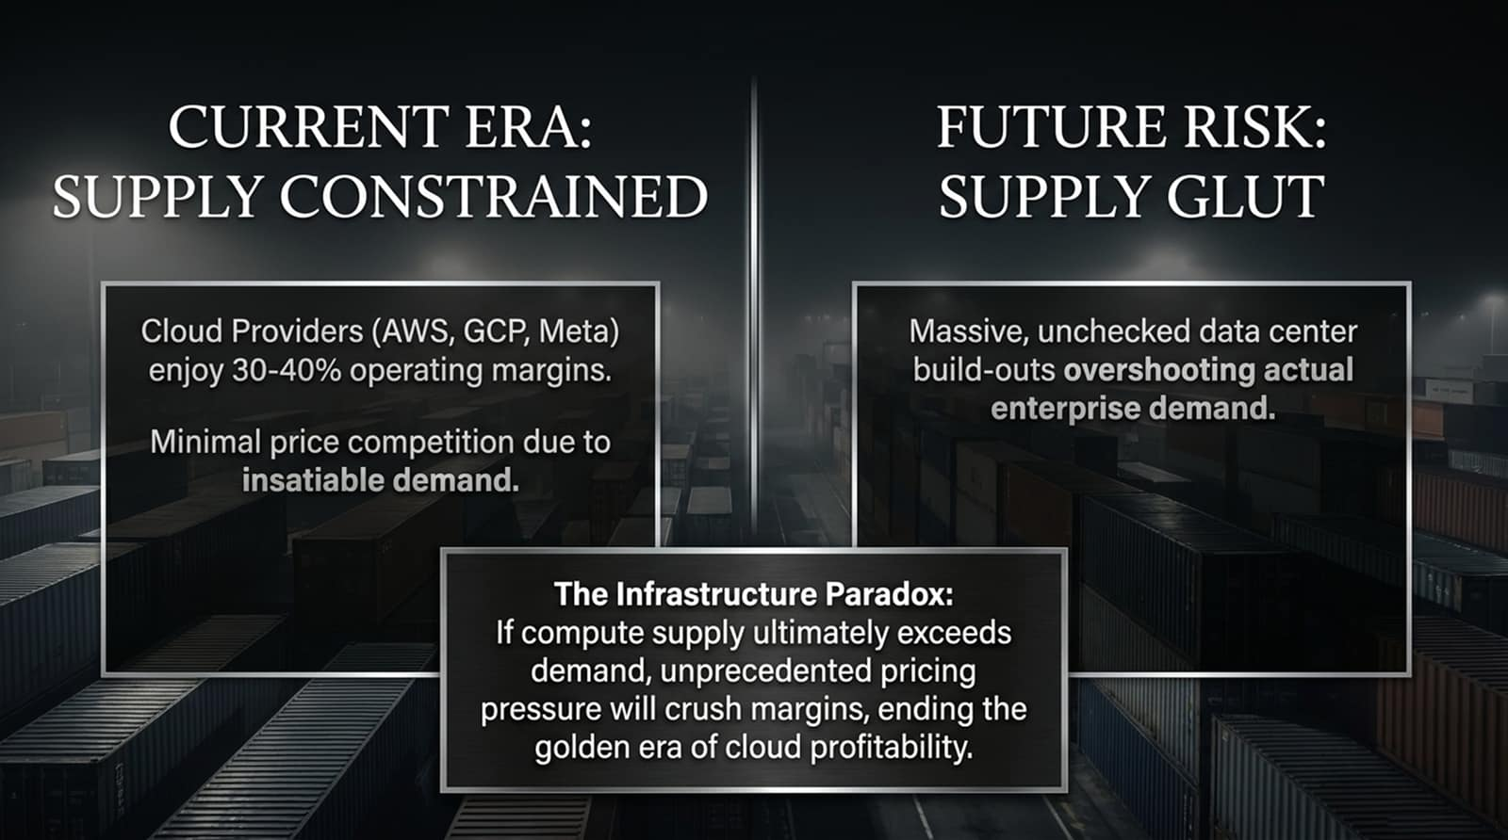
Notes:
Cloud Margin Realities and Future Compute Overbuild Risk
Let's look at the infrastructure layer underlying all of this. Right now, we are in a Supply-Constrained Era. Cloud providers like AWS, GCP, and Meta enjoy massive 30% to 40% operating margins because demand for compute outstrips supply, leaving minimal price competition.
But what happens in the future? The Risk of Supply Glut. Massive, unchecked data center build-outs are currently underway across the tech industry. If physical compute supply ultimately overshoots actual enterprise demand, The Infrastructure Paradox kicks in: unprecedented pricing pressure will crush margins, ending the golden era of cloud profitability. Just like historical commodity cycles, overbuilding leads to margin compression.

Slide 9
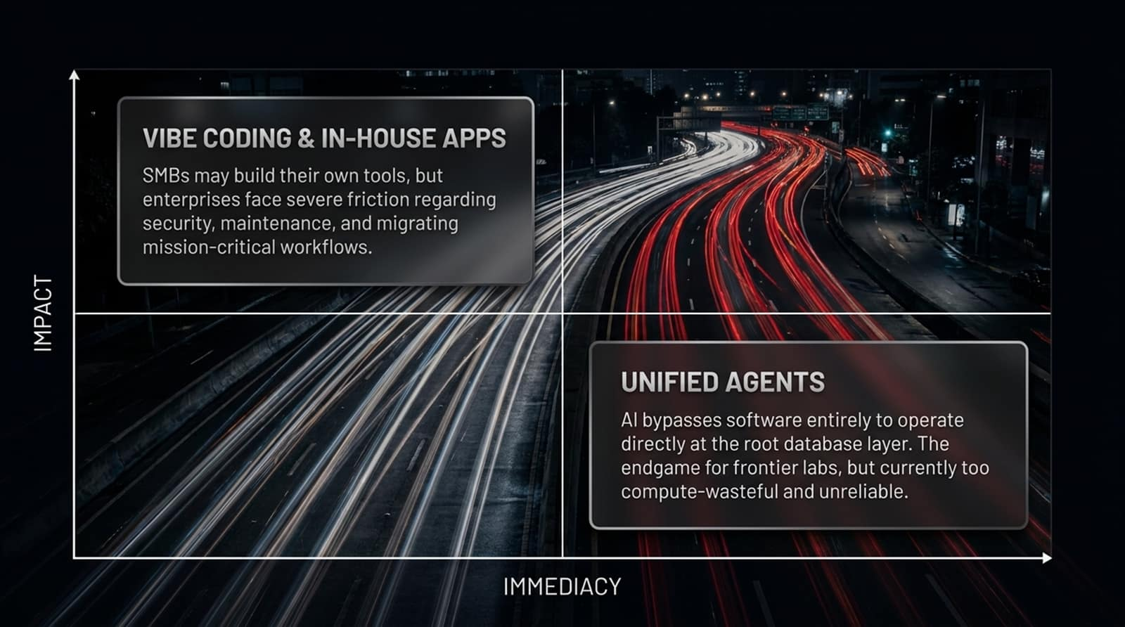
Notes:
Vibe Coding for SMBs vs. Unified Agents for Enterprises
When evaluating how fast software disruption will occur, we can map trends on an Impact vs. Immediacy matrix:
Top-Left (Vibe Coding & In-House Apps): Small and medium businesses (SMBs) can rapidly build custom internal tools using AI prompting. However, large enterprises face severe friction regarding security, compliance, maintenance, and migrating mission-critical workflows.
Bottom-Right (Unified Agents): The ultimate endgame for frontier labs is creating autonomous unified agents that bypass software entirely to operate at the root database layer. However, this approach is currently far too compute-wasteful, prone to hallucinations, and unreliable for enterprise adoption.
Enterprise transformation takes time because reliability and security trump raw speed.

Slide 10
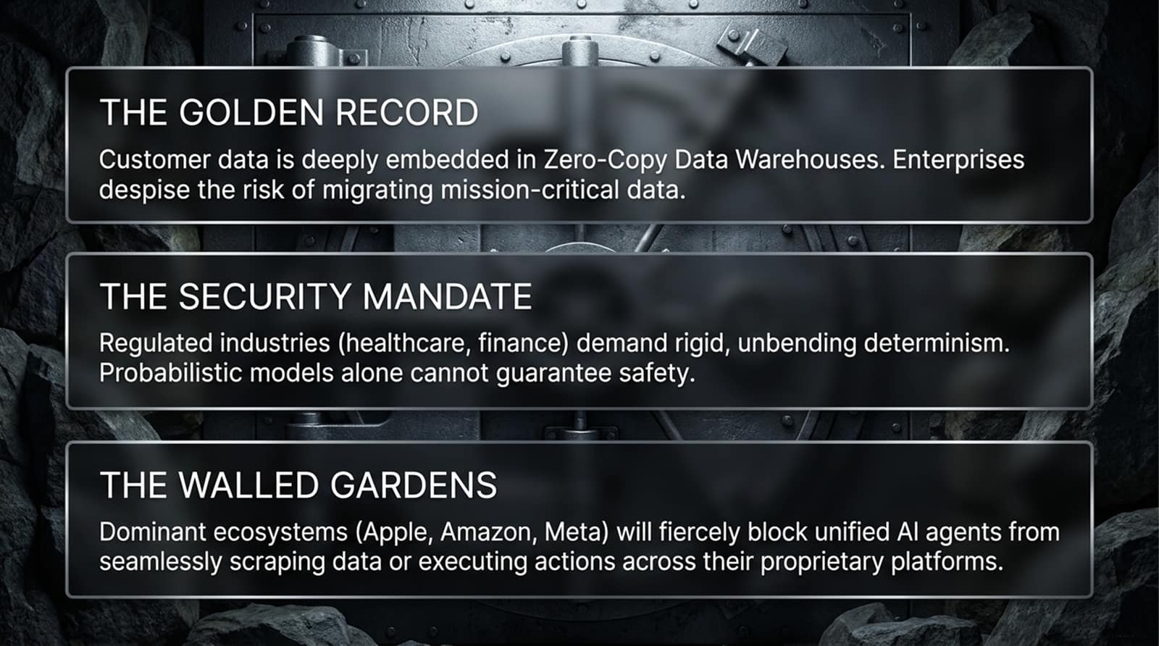
Notes:
The Golden Record, Security Mandates, and Walled Gardens
Why haven't legacy SaaS platforms been wiped out yet? Because three massive defensive walls protect them:
The Golden Record: Customer data is deeply embedded in zero-copy data warehouses and structured enterprise databases. Enterprises absolutely despise the operational risk of migrating mission-critical data to unproven upstarts.
The Security Mandate: Regulated industries like healthcare, finance, and defense demand rigid, unbending determinism and strict compliance audits. Probabilistic models alone cannot guarantee safety or pass regulatory inspections.
The Walled Gardens: Dominant consumer and enterprise ecosystems (Apple, Amazon, Meta) will fiercely block unified AI agents from seamlessly scraping data or executing unvetted actions across their proprietary platforms.
These walls provide incumbent software companies precious time to adapt.

Slide 11
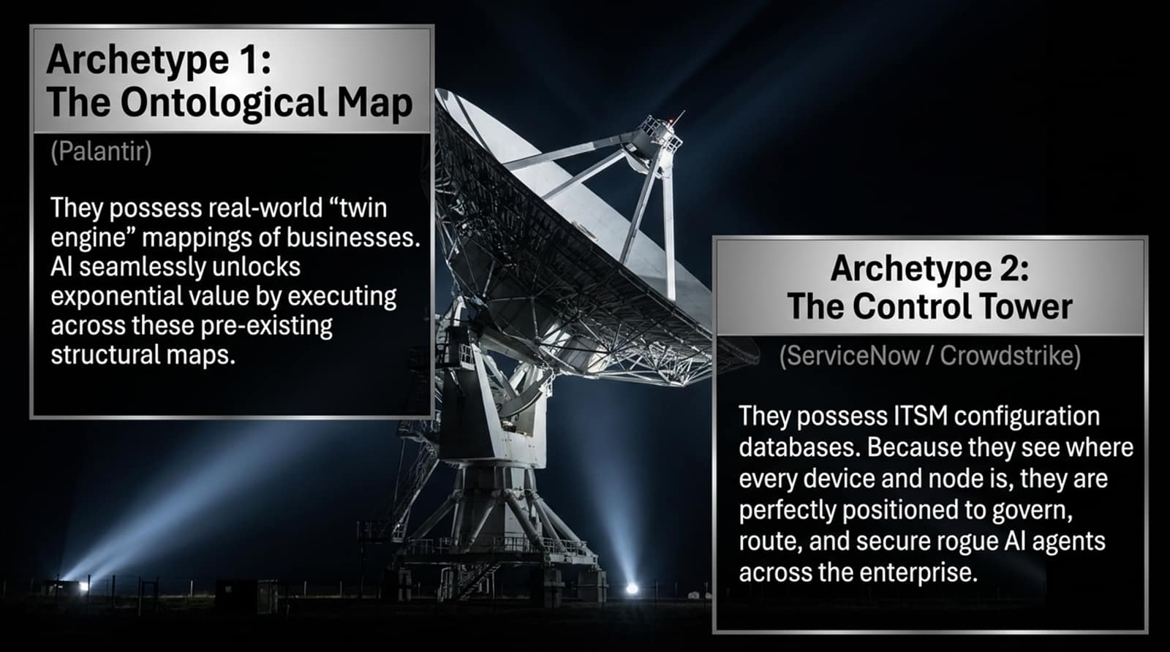
Notes:
Ontological Maps and Control Tower Governance
Some software companies aren't just defending themselves—they are actually thriving in the AI era. Let's look at two successful enterprise archetypes:
Archetype 1: The Ontological Map (Palantir): Palantir possesses real-world 'twin engine' mappings of complex business operations. AI doesn't disrupt Palantir; rather, AI unlocks exponential value by executing actions directly across these pre-existing structural ontological maps.
Archetype 2: The Control Tower (ServiceNow / CrowdStrike): These platforms hold IT service management configuration databases and endpoint telemetry. Because they track where every device and node is located across the enterprise, they are perfectly positioned to govern, route, and secure rogue AI agents.
Owning the foundational map or the security control tower turns AI into a tailwind rather than a threat.

Slide 12
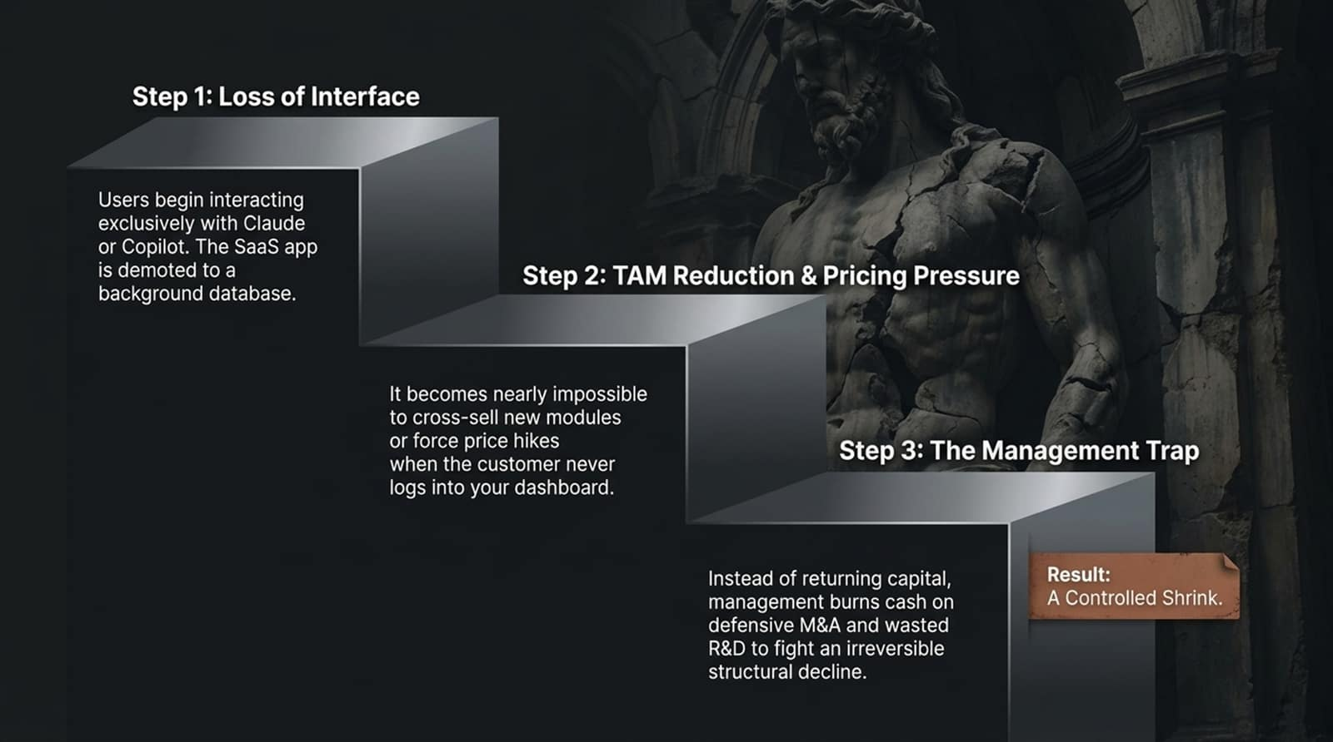
Notes:
Loss of Interface, TAM Reduction, and Controlled Shrink
For legacy SaaS companies that fail to adapt, the decline follows a predictable 3-step trap:
Step 1 (Loss of Interface): Users begin interacting exclusively with AI front-ends like Claude or Copilot. The SaaS app is quietly demoted to a background database.
Step 2 (TAM Reduction & Pricing Pressure): It becomes nearly impossible to cross-sell new modules or force price hikes when the customer never actually logs into your dashboard.
Step 3 (The Management Trap): Instead of returning excess capital to shareholders, management panics, burning cash on defensive M&A and wasted R&D trying to fight an irreversible structural decline.
Result: A slow, agonizing controlled shrink.

Slide 13
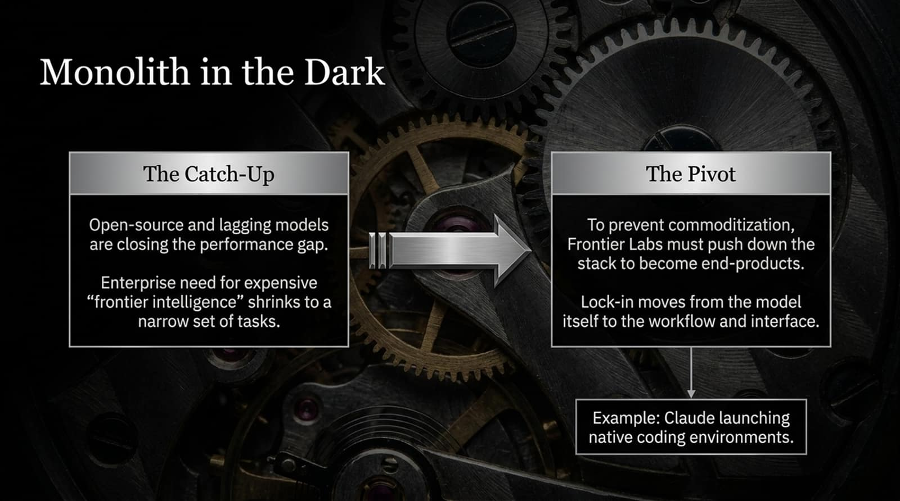
Notes:
Open-Source Catch-Up and Frontier Labs Moving Down-Stack
Even the AI model providers face their own strategic dilemmas—what we call the Monolith in the Dark.
The Catch-Up: Open-source and lagging models (like DeepSeek or Llama derivatives) are rapidly closing the performance gap. The enterprise need for expensive 'frontier intelligence' is shrinking to a very narrow set of complex reasoning tasks.
The Pivot: To prevent commodity pricing pressure on raw APIs, Frontier Labs are forced to push down the stack to become end-products. Lock-in must move from the model itself to the workflow and interface.
Example: Notice how Anthropic launched native coding environments (like Claude Artifacts and specialized coding tools) to capture the end-user workflow directly. Model providers must become application players to survive.

Slide 14
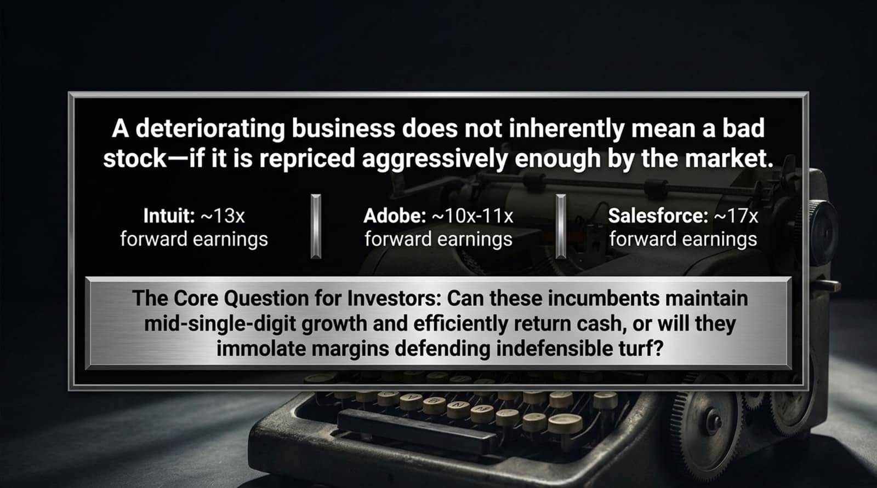
Notes:
Repricing Incumbents and the Forward Earnings Multiple
What does all this mean for investors? As the manifesto points out: A deteriorating business does not inherently make a bad stock—if it is repriced aggressively enough by the market.
Look at the forward earnings multiples across mature software incumbents:
Intuit: Trading around ~13x forward earnings.
Adobe: Trading around ~10x to 11x forward earnings.
Salesforce: Trading around ~17x forward earnings.
The Core Question for Investors: Can these legacy incumbents maintain mid-single-digit growth and efficiently return cash to shareholders, or will they immolate their operating margins defending indefensible turf against AI disruption? Valuation is the ultimate margin of safety.

Slide 15
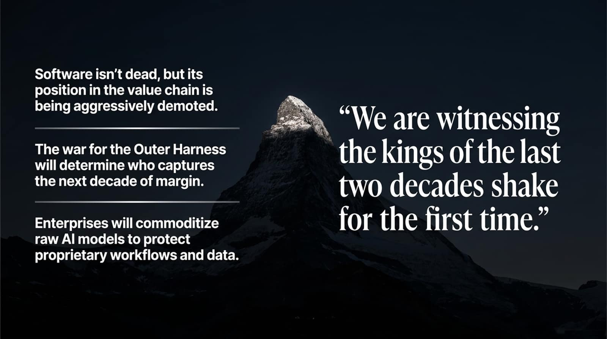
Notes:
Final Summary of Value Chain Reorganization
To synthesize our findings:
Software isn't dead, but its position in the value chain is being aggressively demoted from customer-facing interface to background data pipe.
The war for the Outer Harness will determine who captures enterprise software margin over the next decade.
Enterprises will commoditize raw AI models behind custom internal routers to protect their proprietary data and workflows.
As the closing quote on this slide declares: 'We are witnessing the kings of the last two decades shake for the first time.' The software landscape is undergoing its most radical transformation in computing history.

Slide 16
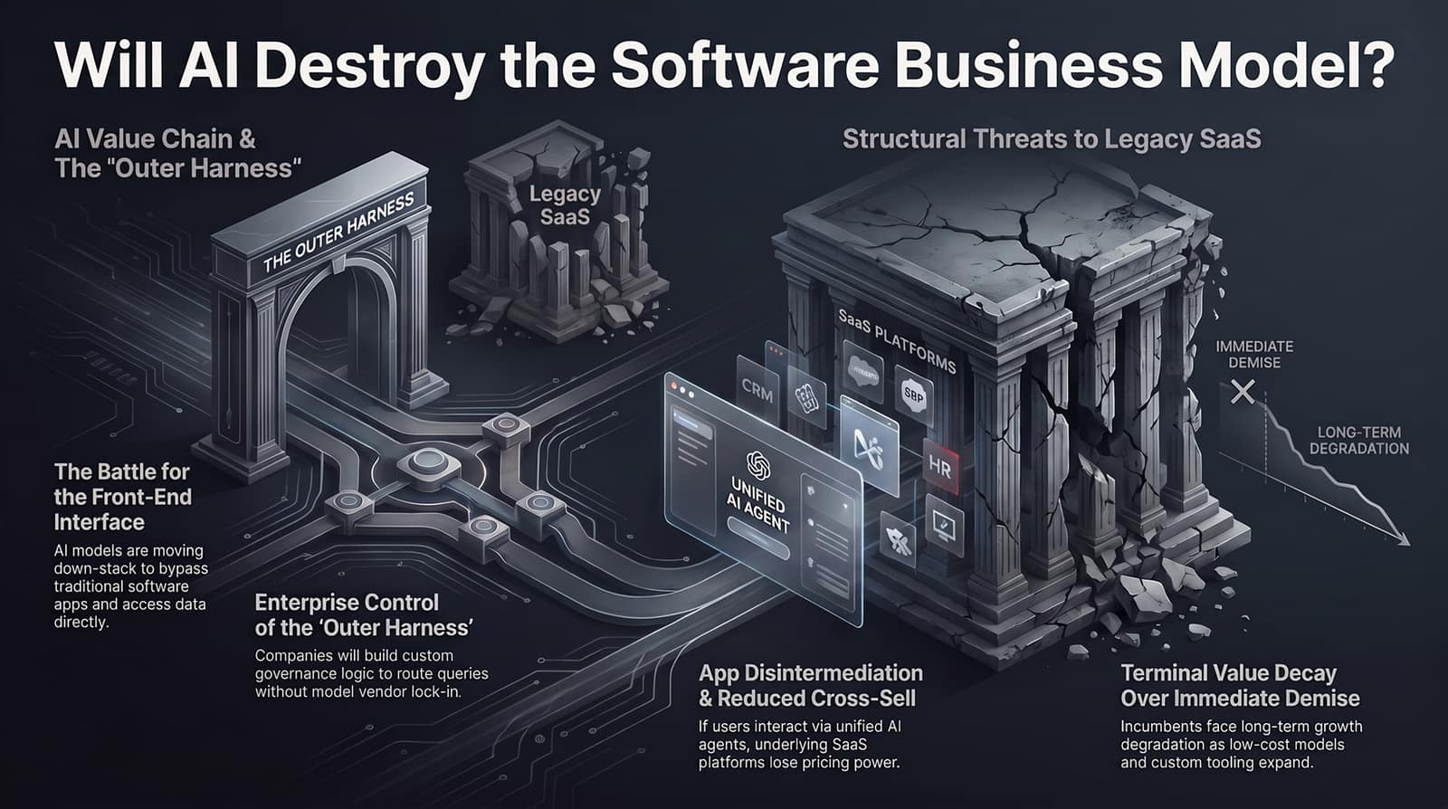
Notes:
Visual Summary of AI Value Chain & SaaS Threats
To conclude, let's review the comprehensive architectural blueprint summarized on this final slide:
The Battle for the Front-End Interface: AI models are moving down-stack to bypass traditional software apps and access data directly.
Enterprise Control of the Outer Harness: Companies are building custom governance logic to route queries without vendor lock-in.
App Disintermediation: As users interact via unified AI agents, underlying SaaS platforms lose pricing power and cross-sell velocity.
Terminal Value Decay: Incumbents face long-term growth degradation as low-cost models and custom tooling expand.
Understanding this structural reorganization allows investors and engineers to navigate the AI disruption with clarity rather than fear.
Thank you! Let's open the floor to questions.

